Slide 1
Priority Scheduling Algorithm

Slide 2
Agenda
Introduction
Goal
HL
Diagram
Data structure
Tests

Slide 3
Introduction
Background
Efficient task management in drone operations is critical for optimal performance and resource utilization. Drones perform various tasks, each with its own priority and urgency.
Why We Need This Part
This module is essential to handle multiple tasks with varying priorities.
By using separate queues for each task type and assigning a weight based on priority, we ensure higher-priority tasks receive more attention and resources,
crucial for scenarios like emergency responses or real-time surveillance.
How It Relates to the Overall System
The module uses a weighted Round Robin (RR) scheduling algorithm where the time quantum is based on task priority.
This ensures higher-priority tasks run more frequently and for longer periods.
For example, a high-priority mapping task for a specific area will receive more CPU time, supporting efficient operator requests while still accommodating other tasks.
This balanced approach maintains overall operational efficiency and responsiveness.

Slide 4
Goal
Efficiently manage and prioritize drone tasks using a weighted Round Robin (RR) scheduling algorithm
to ensure optimal performance and resource utilization.
Expected Outcomes:
Efficient Task Scheduling:Execute tasks based on priority, with higher-priority tasks receiving more processing time.
Optimized Resource Utilization:Balance the load across task queues according to their assigned weights.
Improved Response Times:Reduce response times for critical tasks by allocating more CPU time to high-priority tasks.
Fairness in Task Execution:Ensure all tasks get a fair turn to execute while prioritizing important ones.
Scalability and Flexibility:Adapt to varying task loads and priority levels, maintaining consistent performance.
Enhanced Operational Efficiency:Support the operator in efficiently executing missions,
such as quickly finding the best drones for aerial imaging.

Slide 5
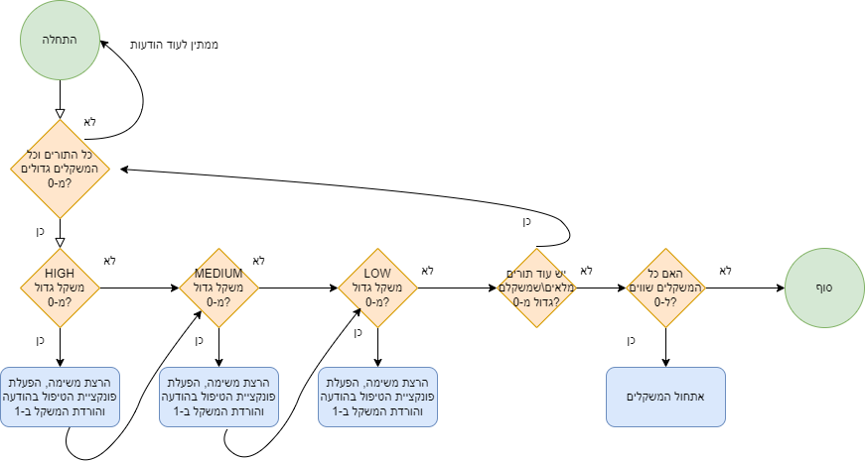
Diagram
This diagram represents the flow and prioritization of tasks in the drone management system.
Yes

Slide 6
Data structure
Message: responsible for representing messages within the system and includes essential parameters that facilitate communication and data transfer.
Queue: Separate priority queues for tasks of different priorities with weights according to priority.
Message Params: Parameters related to the handling function of a particular message are stored in a structure in the form of UNION.
Message Type: The type of message being sent.
Priority: Setting a priority for each message.

Slide 7
Testing
Testing Strategies
Unit Tests:
What to Test: Each function within the scheduling algorithm to ensure it behaves as expected for different input scenarios and edge cases.
How to Test: Run unit tests on each function with various inputs and verify the correct output.
Integration Tests:
What to Test: Verify that the scheduling module interacts correctly with the Communication API, Timer API, and Status Monitoring API.
How to Test: Run integration tests between the scheduling module and other interfaces, ensuring that communication works as expected.

Slide 8
Performance Tests:
What to Test: Measure the efficiency and response times of the scheduling algorithm under varying task loads and priorities.
How to Test: Conduct performance tests and measure response times and efficiency under different load conditions.
Stress Tests:
What to Test: Evaluate how the system performs under heavy task loads, ensuring it maintains stability and meets performance expectations.
How to Test: Run stress tests on the system and verify stability and performance under heavy loads.

Slide 9
Use Cases
Single Queue Processing
What to Test: Processing all tasks in a single priority queue.
How to Test: Set up a single queue with several tasks and a specific priority, run the algorithm, and ensure all tasks in the queue are processed. Verify that the queue is empty at the end of processing.
Time Quantum Update
What to Test: Updating the time quantum after each task.
How to Test: Set up a queue with a single task and a specific priority, run the algorithm, and ensure the time quantum updates correctly after processing the task. Verify that the time quantum changes appropriately after each task execution.

Slide 10
Integration Tests
Mixed Priority Task Processing
What to Test: Processing tasks from queues with different priorities.
How to Test: Set up queues with different priorities (High, Medium, Low) and tasks in each queue, run the algorithm, and ensure all tasks in all queues are processed. Verify that all queues are empty at the end of processing.
Single Task in Multiple Queues
What to Test: Processing single tasks distributed across multiple queues with different priorities.
How to Test: Set up multiple queues, each containing a single task with a specific priority, run the algorithm, and ensure each task is processed according to its queue's priority. Verify that all queues are empty at the end of processing.
Handling Empty Queues
What to Test: The algorithm correctly handles empty queues.
How to Test: Set up queues with some containing tasks and some empty, run the algorithm, and ensure it correctly transitions between queues, including empty ones. Verify that all non-empty queues are empty at the end of processing.

Slide 11
Starvation Check
What to Test: Ensuring that low-priority tasks are not starved by high-priority tasks.
How to Test: Set up queues with a large number of high-priority tasks and a few low-priority tasks, run the algorithm, and ensure that low-priority tasks are processed. Verify that the low-priority queue is empty at the end of processing.
Handling Many Queues
What to Test: Processing tasks from a large number of queues.
How to Test: Set up a large number of queues with varying numbers of tasks, run the algorithm, and ensure all tasks from all queues are processed. Verify that all queues are empty at the end of processing.
Large Number of Tasks
What to Test: Processing a large number of tasks in a single queue.
How to Test: Set up a queue with a large number of tasks, run the algorithm, and ensure all tasks in the queue are processed. Verify that the queue is empty at the end of processing.

Slide 12
Zero Weight Queues
What to Test: Handling queues with zero weight.
How to Test: Set up multiple queues, one with zero weight, run the algorithm, and ensure that the zero-weight queue is not processed. Verify that the non-zero weight queue is empty at the end of processing.
Task Waiting Time Check
What to Test: Checking the waiting time for tasks to ensure they are processed in a timely manner.
How to Test: Set up multiple queues with different priorities and tasks, record the entry times for each task, run the algorithm, and ensure tasks are processed within a specific time limit. Verify that the waiting time for each task does not exceed the maximum time allowed.

Slide 13
Unit Tests for Handler Function
Overview and Objectives
This presentation provides an overview of the unit tests designed for the Handler function in the Queue system. The tests aim to ensure that the correct handling functions are called for various message types. The objective is to verify that the Handler function processes different message types correctly by invoking the appropriate functions.

Slide 14
Test Cases Overview
The following tests were designed to verify that the Handler function correctly processes different types of messages by invoking the appropriate handling functions:
M_GOT_REQ
MTS_ASK_FOR_IMAGES
STM_SEND_IMAGES_PROP
MTS_GIVE_THE_CHOSEN_IMAGE
STM_RESPONSE_TO_THE_CHOSEN_IMAGE
MTS_SEND_EVENTS
MTS_GET_SORTED_EVENTS_LIST_FROM_SLAVES

Slide 15
Global Variables and Mock Functions
The tests include global variables to monitor function calls and mock functions designed to test the behavior of the Handler function for different message types. The global variables track whether a specific function was called during the test.

Slide 16
Testing Approach
For each message type, the following approach was taken:
Add the message to the queue.
Override the function pointer for the message type with a mock function.
Call the Handler function.
Verify that the mock function was called, indicating correct handling of the message.

Slide 17
Thank you
Brita Tamm
502-555-0152
brita@firstupconsultants.com
www.firstupconsultants.com

